Slide 1



377 Operating Systems
Lecture 08: Introduction to Concurrency

Slide 2

Virtualization: Processes
Reality: Single CPU
Virtualization: Multiple Processes
Notes:
Thus far, we have seen the development of the basic abstractions that the OS performs. We have seen how to take a single physical CPU and turn it into multiple virtual CPUs, thus enabling the illusion of multiple programs running at the same time.

Slide 3
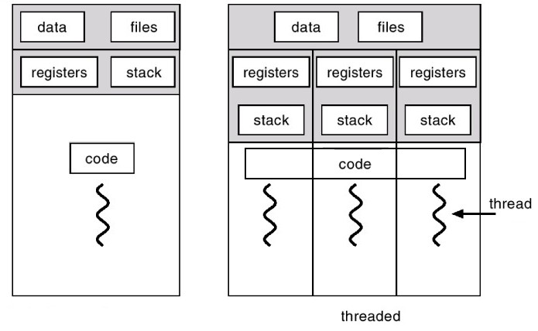
Another Abstraction: Threads
Notes:
The state of a single thread is thus very similar to that of a process. It has a program counter (PC) that tracks where the program is fetching instructions from. Each thread has its own private set of registers it uses for computation; thus, if there are two threads that are running on a single processor, when switching from running one (T1) to running the other (T2), a context switch must take place. The context switch between threads is quite similar to the context switch between processes, as the register state of T1 must be saved and the register state of T2 restored before running T2. With processes, we saved state to a process control block (PCB); now, we’ll need one or more thread control blocks (TCBs) to store the state of each thread of a process. There is one major difference, though, in the context switch we perform between threads as compared to processes: the address space remains the same (i.e., there is no need to switch which page table we are using).

Slide 4
Another Abstraction: Threads
Process Control Block (PCB)
Thread Control Block (TCB)
Notes:
The state of a single thread is thus very similar to that of a process. It has a program counter (PC) that tracks where the program is fetching instructions from. Each thread has its own private set of registers it uses for computation; thus, if there are two threads that are running on a single processor, when switching from running one (T1) to running the other (T2), a context switch must take place. The context switch between threads is quite similar to the context switch between processes, as the register state of T1 must be saved and the register state of T2 restored before running T2. With processes, we saved state to a process control block (PCB); now, we’ll need one or more thread control blocks (TCBs) to store the state of each thread of a process. There is one major difference, though, in the context switch we perform between threads as compared to processes: the address space remains the same (i.e., there is no need to switch which page table we are using).

Slide 5
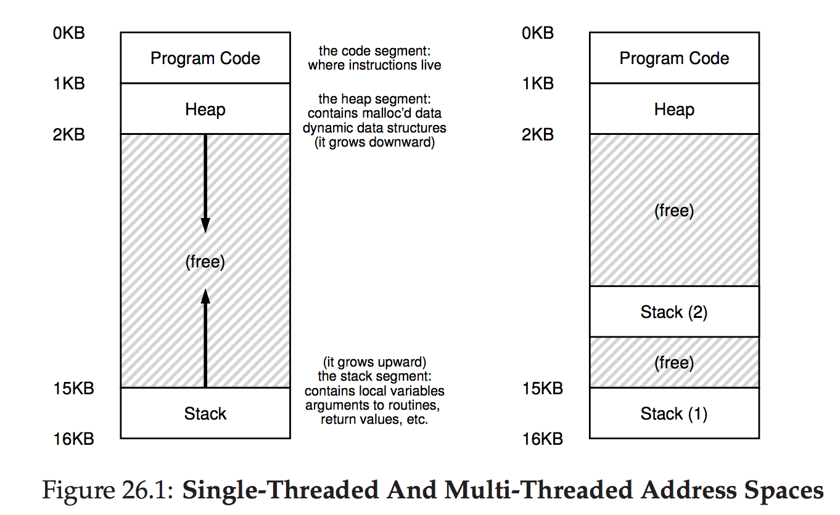
Single-Threaded and Multi-Threaded Address Space
Thread Local Storage
Notes:
The state of a single thread is thus very similar to that of a process. It has a program counter (PC) that tracks where the program is fetching instructions from. Each thread has its own private set of registers it uses for computation; thus, if there are two threads that are running on a single processor, when switching from running one (T1) to running the other (T2), a context switch must take place. The context switch between threads is quite similar to the context switch between processes, as the register state of T1 must be saved and the register state of T2 restored before running T2. With processes, we saved state to a process control block (PCB); now, we’ll need one or more thread control blocks (TCBs) to store the state of each thread of a process. There is one major difference, though, in the context switch we perform between threads as compared to processes: the address space remains the same (i.e., there is no need to switch which page table we are using).

Slide 6
Why Use Threads?
The first one is simple: parallelism
Imagine you are writing a program that performs operations on very large arrays, for example, adding two large arrays together, or incrementing the value of each element in the array by some amount.

Slide 7
Why Use Threads?
The first one is simple: parallelism
Imagine you are writing a program that performs operations on very large arrays, for example, adding two large arrays together, or incrementing the value of each element in the array by some amount.
If you are running on just a single processor, the task is straightforward: just perform each operation and be done.

Slide 8
Why Use Threads?
The first one is simple: parallelism
Imagine you are writing a program that performs operations on very large arrays, for example, adding two large arrays together, or incrementing the value of each element in the array by some amount.
If you are running on just a single processor, the task is straightforward: just perform each operation and be done.
However, if you are executing the program on a system with multiple processors, you have the potential of speeding up this process considerably by using the processors to each perform a portion of the work.

Slide 9
Why Use Threads?
The second reason is more subtle: to avoid blocking program progress due to slow I/O

Slide 10
Why Use Threads?
The second reason is more subtle: to avoid blocking program progress due to slow I/O
Imagine that you are writing a program that performs different types of I/O: either waiting to send or receive a message, for an explicit disk I/O to complete, or even (implicitly) for a trap/fault to finish.

Slide 11
Why Use Threads?
The second reason is more subtle: to avoid blocking program progress due to slow I/O
Imagine that you are writing a program that performs different types of I/O: either waiting to send or receive a message, for an explicit disk I/O to complete, or even (implicitly) for a trap/fault to finish.
Instead of waiting, your program may wish to do something else, including utilizing the CPU to perform computation, or even issuing further I/O requests. Using threads is a natural way to avoid getting stuck.

Slide 12
Why Use Threads?
The second reason is more subtle: to avoid blocking program progress due to slow I/O
while one thread in your program waits (i.e., is blocked waiting for I/O), the CPU scheduler can switch to other threads, which are ready to run and do something useful.

Slide 13
Why Use Threads?
The second reason is more subtle: to avoid blocking program progress due to slow I/O
while one thread in your program waits (i.e., is blocked waiting for I/O), the CPU scheduler can switch to other threads, which are ready to run and do something useful.
Threading enables overlap of I/O with other activities within a single program, much like multiprogramming did for processes across programs.

Slide 14
Why Use Threads?
The second reason is more subtle: to avoid blocking program progress due to slow I/O
while one thread in your program waits (i.e., is blocked waiting for I/O), the CPU scheduler can switch to other threads, which are ready to run and do something useful.
Threading enables overlap of I/O with other activities within a single program, much like multiprogramming did for processes across programs.
Examples: many modern server-based applications (web servers, database management systems, and the like) make use of threads in their implementations.

Slide 15
Why Not Use Processes?
Of course, in either of the cases mentioned above, you could use multiple processes instead of threads.

Slide 16
Why Not Use Processes?
Of course, in either of the cases mentioned above, you could use multiple processes instead of threads.
However, threads share an address space and thus make it easy to share data.

Slide 17
Why Not Use Processes?
Of course, in either of the cases mentioned above, you could use multiple processes instead of threads.
However, threads share an address space and thus make it easy to share data.
Thus, threads are a natural choice when constructing these types of programs.
Processes are a more sound choice for logically separate tasks where little sharing of data structures in memory is needed.

Slide 18
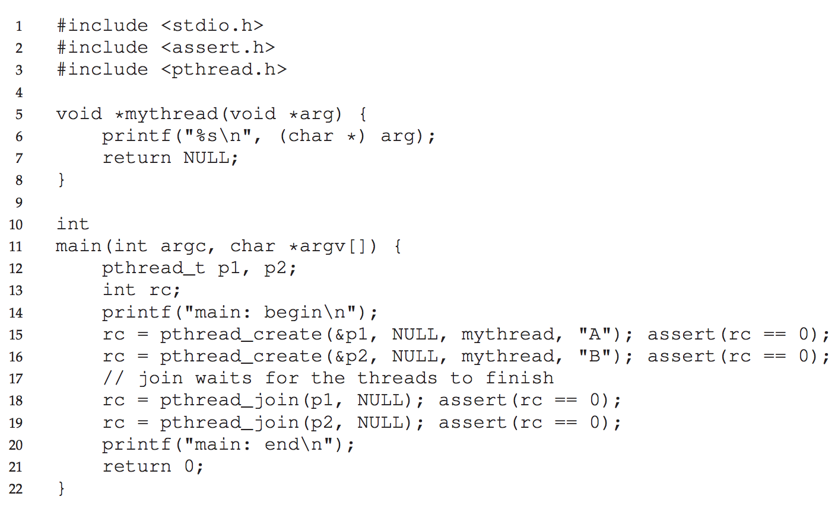
Thread Example

Slide 19
Thread Example

Slide 20
Thread Example

Slide 21
Thread Example

Slide 22
Thread Example

Slide 23
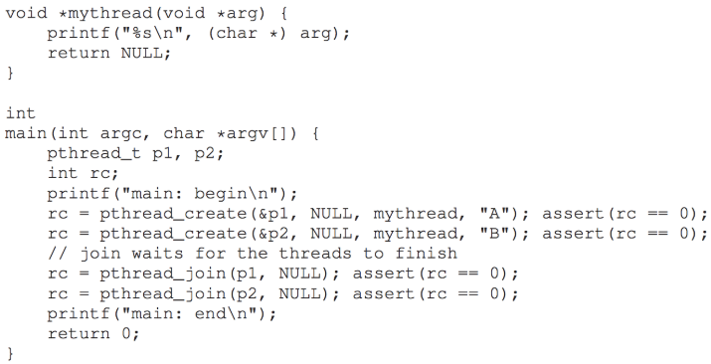
Question
Which prints first A or B?
Notes:
d

Slide 24
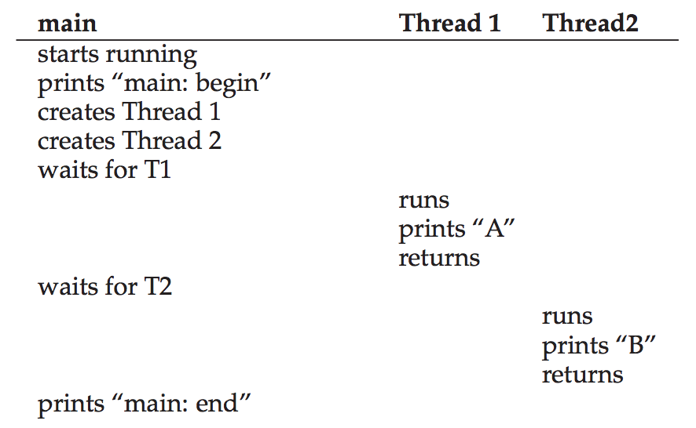
Thread Trace (1)

Slide 25
Thread Trace (1)

Slide 26
Thread Trace (1)

Slide 27
Thread Trace (1)

Slide 28
Thread Trace (1)

Slide 29
Thread Trace (1)

Slide 30
Thread Trace (1)

Slide 31
Thread Trace (1)

Slide 32
Thread Trace (1)

Slide 33
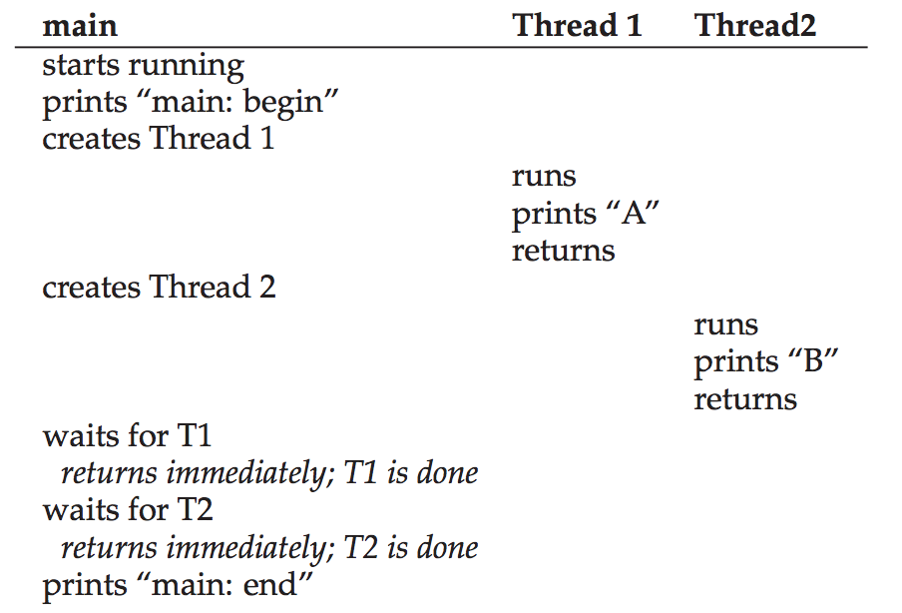
Thread Trace (2)

Slide 34
Thread Trace (2)

Slide 35
Thread Trace (2)

Slide 36
Thread Trace (2)

Slide 37
Thread Trace (2)

Slide 38
Thread Trace (2)

Slide 39
Thread Trace (2)

Slide 40
Thread Trace (2)

Slide 41
Thread Trace (2)

Slide 42
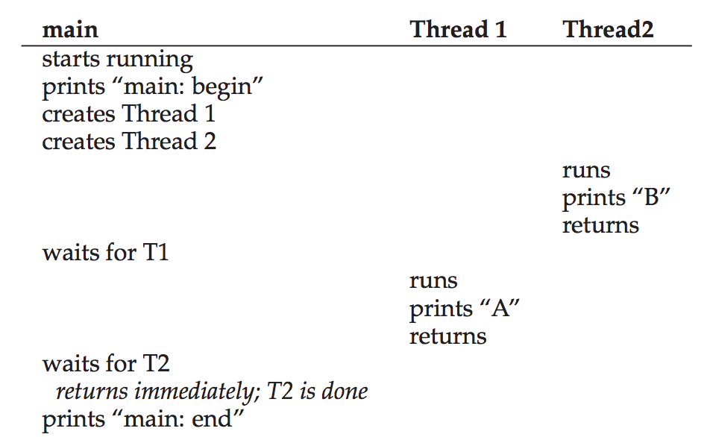
Thread Trace (3)

Slide 43
Thread Trace (3)

Slide 44
Thread Trace (3)

Slide 45
Thread Trace (3)

Slide 46
Thread Trace (3)

Slide 47
Thread Trace (3)

Slide 48
Thread Trace (3)

Slide 49
Thread Trace (3)

Slide 50
Thread Trace (3)

Slide 51
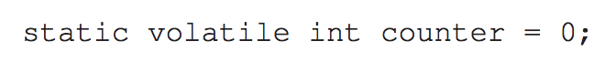
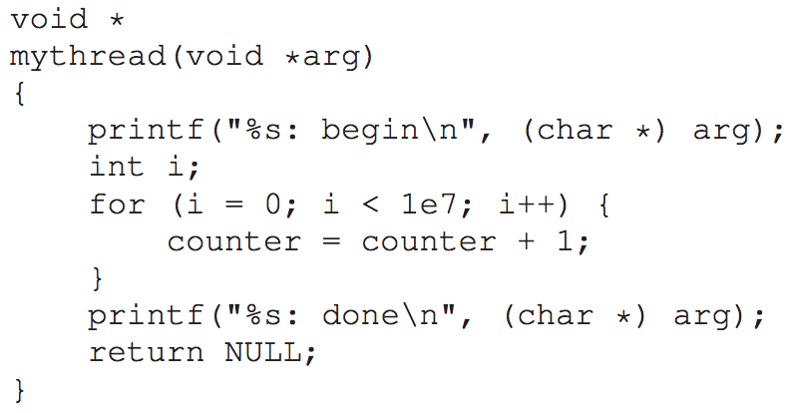
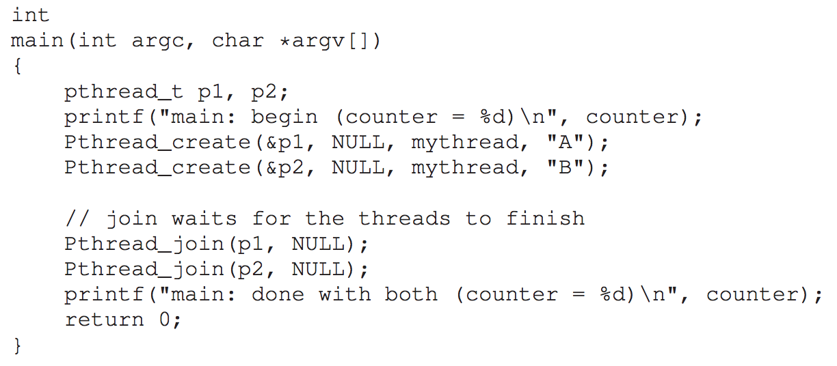
Threads are useful, but there are problems.

Slide 52
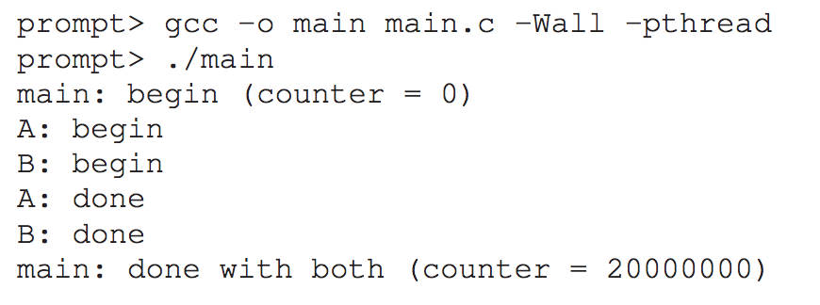
Threads are useful, but there are problems.

Slide 53
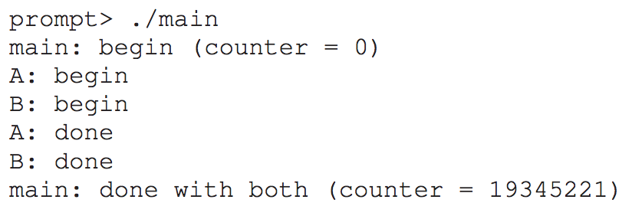
Threads are useful, but there are problems.

Slide 54
Threads are useful, but there are problems.

Slide 55
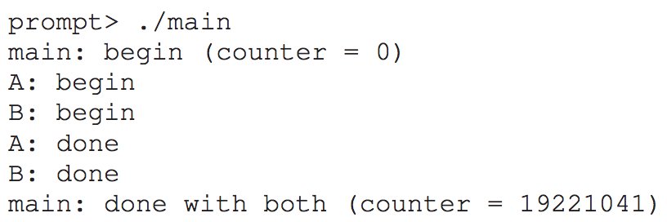
Threads are useful, but there are problems.
Aren’t computers supposed to produce deterministic results, as you have been taught?!
Not only is each run wrong, but also yields a different result!
A big question remains: why does this happen?

Slide 56
The Heart of the Problem: Uncontrolled Scheduling
To understand why this happens, we must understand the code sequence that the compiler generates for the update to counter. In this case, we wish to simply add a number (1) to counter.

Slide 57
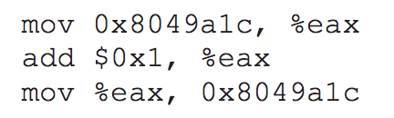
The Heart of the Problem: Uncontrolled Scheduling
To understand why this happens, we must understand the code sequence that the compiler generates for the update to counter. In this case, we wish to simply add a number (1) to counter.
Thus, the code sequence for doing so might look something like this (in x86):

Slide 58
The Heart of the Problem: Uncontrolled Scheduling
To understand why this happens, we must understand the code sequence that the compiler generates for the update to counter. In this case, we wish to simply add a number (1) to counter.
Thus, the code sequence for doing so might look something like this (in x86):
counter

Slide 59
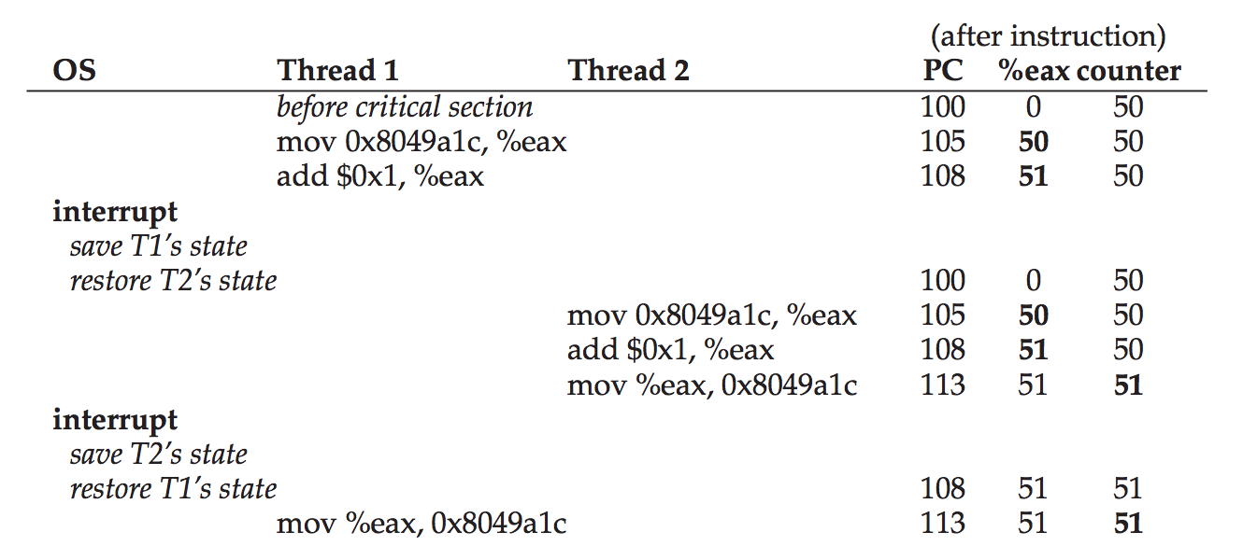
The Heart of the Problem: Uncontrolled Scheduling

Slide 60
The Heart of the Problem: Uncontrolled Scheduling

Slide 61
The Heart of the Problem: Uncontrolled Scheduling

Slide 62
The Heart of the Problem: Uncontrolled Scheduling

Slide 63
The Heart of the Problem: Uncontrolled Scheduling

Slide 64
The Heart of the Problem: Uncontrolled Scheduling
RACE CONDITION!

Slide 65
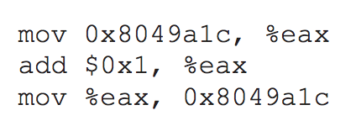
The Wish for Atomicity
The problem is that we must execute 3 instructions to perform the increment:

Slide 66
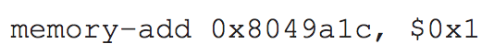
The Wish for Atomicity
The problem is that we must execute 3 instructions to perform the increment:
What if we could do this with only a single atomic instruction:

Slide 67
The Wish for Atomicity
Thus, what we will instead do is ask the hardware for a few useful instructions upon which we can build a general set of what we call synchronization primitives.
By using these hardware synchronization primitives, in combination with some help from the operating system, we will be able to build multi-threaded code that accesses critical sections in a synchronized and controlled manner.

Slide 68
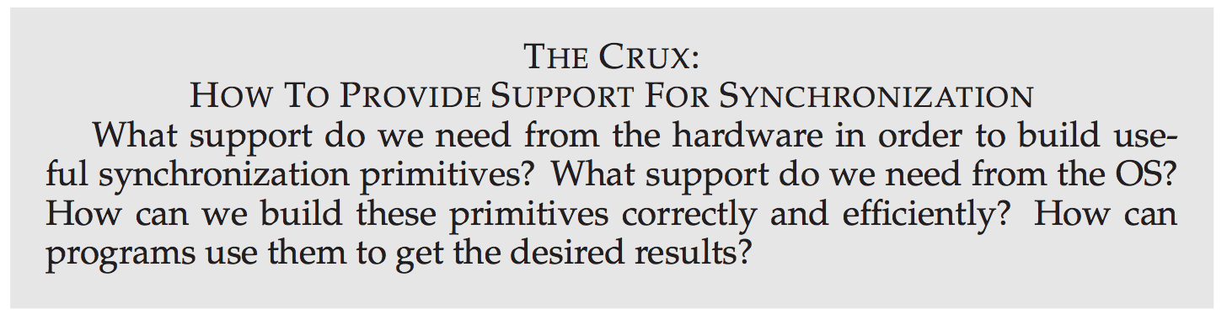

Slide 69
One more problem: waiting for another
We have set up the problem of concurrency as if only one type of interaction occurs between threads: accessing shared variables and the need to support atomicity for critical sections.

Slide 70
One more problem: waiting for another
We have set up the problem of concurrency as if only one type of interaction occurs between threads: accessing shared variables and the need to support atomicity for critical sections.
As it turns out, there is another common interaction that arises: One thread must wait for another to complete some action before it continues.
This interaction arises, for example, when a process performs a disk I/O and is put to sleep; when the I/O completes, the process needs to be roused from its slumber so it can continue.

Slide 71
One more problem: waiting for another
We have set up the problem of concurrency as if only one type of interaction occurs between threads: accessing shared variables and the need to support atomicity for critical sections.
As it turns out, there is another common interaction that arises: One thread must wait for another to complete some action before it continues.
This interaction arises, for example, when a process performs a disk I/O and is put to sleep; when the I/O completes, the process needs to be roused from its slumber so it can continue.
We will be looking at how synchronization primitives and conditional variables help tame uncontrolled scheduling.

Slide 72
Why study this in an OS class?
Before wrapping up, one question that you might have is: why are we studying this in OS class?
“History” is the one-word answer!
The OS was the first concurrent program, and many techniques were created for use within the OS. Later, with multi-threaded processes, application programmers also had to consider such things.

Slide 73

The End

